Slide 1
Lock-free data structure in C++
Xue Qi

Slide 2
Atomic data types in C++
std::atomic_bool
std::atomic_char
std::atomic_signed_char
std::atomic_unsigned_char
std::atomic_short
std::atomic_unsigned_short
std::atomic_int
std::atomic_unsigned_int
std::atomic_long
std::atomic_unsigned_long
std::atomic_long_long
std::atomic_unsigned_long_long
std::atomic_wchar_t
std::atomic_char16_t
std::atomic_char32_t
std::atomic<float> (optional)
std::atomic<double> (optional)
std::atomic<void*>
std::atomic<T> (for trivially copyable user-defined types)
Atomic data types are types for which operations can be performed atomically, meaning they are thread-safe and prevent race conditions in multi-threaded environments.
is_lock_free is a runtime function that returns whether a specific instance of an atomic type is lock-free on the current platform.
is_always_lock_free is a compile-time constant that specifies whether all instances of a given atomic type are guaranteed to be lock-free across all instances and on all platforms where the code runs.

Slide 3
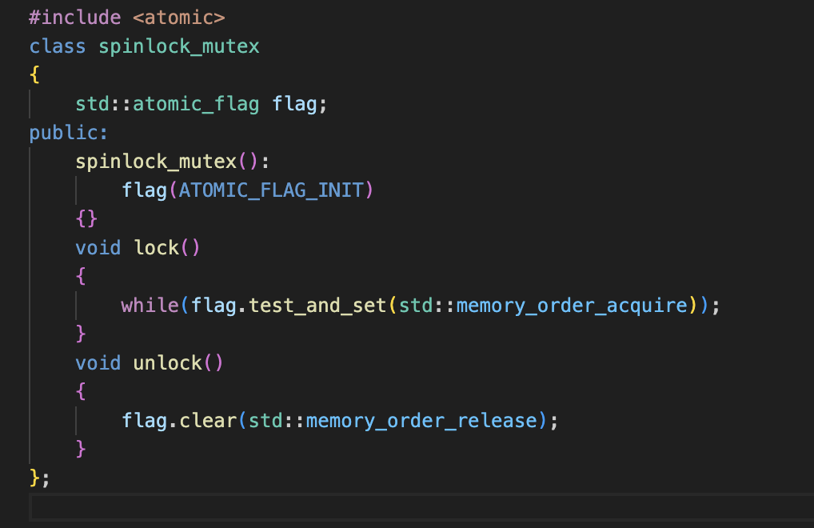
std::atomic_flag
Always lock-free: Ensures atomicity without requiring locks, even on platforms with limited atomic support.
Boolean-like functionality: Can be set (true) or cleared (false).
No copying or assignment: Cannot be copied or assigned, only manipulated atomically.
Operations:
test_and_set()
Atomically sets the flag to true and returns the previous value.
clear()
Atomically clears the flag to false.

Slide 4
Atomic vs Mutex
std::atomic
Pros
Faster Performance: Avoids locking overhead
Non-Blocking: reduced deadlock risk
Simple for Single Variables: Ideal for counters, flags, pointers
Cons
Limited to Single Variables: Not for complex data
Hard for Complex Operations: Writing lock-free code is challenging
Platform Dependency: Not always lock-free on all systems
std::mutex
Pros
Versatile: Can protect complex structures or multi-variable operations
Easy to Use: Wraps any critical section in a lock
Cross-Platform: Consistent behavior across systems
Cons
Performance Overhead: Locks add latency
Blocking Risk: Can lead to deadlocks
Context Switch Cost: Blocking threads may slow performance

Slide 5
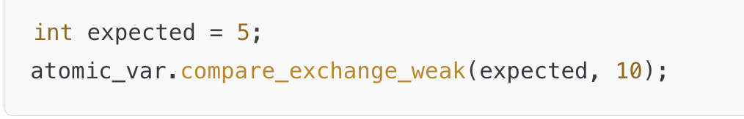
Atomic Variable Methods
store(value)
Atomically sets the atomic variable to the specified value.
load()
Atomically retrieves the current value of the atomic variable.
exchange(value)
Atomically replaces the current value with value and returns the old value.
Example: int old_value = atomic_var.exchange(10);
compare_exchange_weak(expected, desired)
Atomically sets the value to desired if the current value is equal to expected. Otherwise, updates expected to the current value.
Weak version may fail spuriously (useful in loops).
compare_exchange_strong(expected, desired)
Similar to compare_exchange_weak but does not fail spuriously. Use for single comparison attempts outside loops.

Slide 6
Memory ordering in atomic operations
Memory ordering in atomic operations specifies the order in which memory operations (reads and writes) are seen by multiple threads in a C++ program.
memory_order_relaxed: When only atomicity is needed, not ordering.
memory_order_acquire and memory_order_release: When a thread needs to synchronize with other threads but only in one direction (acquire for reads, release for writes).
memory_order_acq_rel: When an operation needs to synchronize in both directions, ensuring that all reads and writes happen in the intended order.
memory_order_seq_cst: When strict ordering across all threads is needed; the safest but potentially slowest.

Slide 7
Examples
Print in order
Atomic: https://leetcode.com/problems/print-in-order/submissions/1449809149/
Mutex: https://leetcode.com/problems/print-in-order/submissions/1449829959/
Building H2O
Mutex: https://leetcode.com/problems/building-h2o/submissions/1449927149/
Atomic: https://leetcode.com/problems/building-h2o/submissions/1449930998/

